Slide 1
Prioritizing Effective Interventions for Key Populations in PEPFAR 2021 COP Development
Nadia Rafif – Director of Policy, Mpact
www.mpactglobal.org
January 28, 2021

Slide 2
Nadia Rafif @ MPact Global Action
What types of policies to advocate for in PEPFAR program implementation and other effective strategies to improve the HIV response for gay, bisexual and other men having sex with men
Michael Ighodaro and Kevin Fisher, @AVAC
Strategies to improve access to HIV testing, treatment, care and prevention for key populations (MSM, FSW, PWUD, TG) in COPs
Brian Honermann @ Amfar
How to read and understand PEPFAR data on key population programming
Marineus Mwombeki, Tanzania
Sharing successes and challenges on engaging with PEPFAR

Slide 3
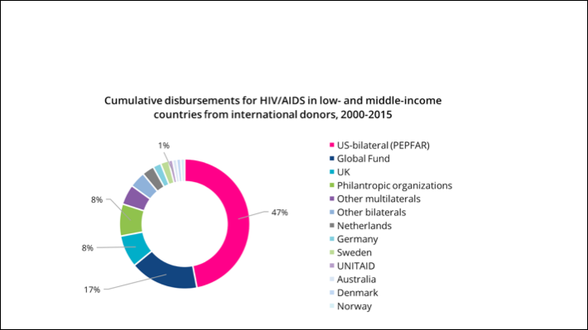
Why focus on PEPFAR?
Notes:
The U.S. President’s Emergency Plan for AIDS Relief (PEPFAR) is the world’s largest bilateral health program solely dedicated to combating a single disease. PEPFAR funding has amounted
to more than US$90 billion dollars to date, including US$6.9 billion for fiscal year 2020 (both of these figures include the U.S. contribution to the Global Fund to Fight AIDS, TB and Malaria,
where the U.S. is the single largest donor nation).1
The U.S. President’s Emergency Plan for AIDS Relief (PEPFAR) is the largest source of funding for the HIV response globally, with most funding focused in Sub-Saharan Africa, Haiti, and in smaller regional programs in Asia, the Caribbean, and Latin America. PEPFAR is often the largest single source of money for HIV—often larger than the Global Fund and more than government in some countries. In other countries, PEPFAR provides smaller portions of total funding, but often for services that no other funding support including key populations funding.

Slide 4
What are Pepfar Cop’s?
Country Operational Plans
Set out PEPFAR’s strategy for the following year (COP 21 will decide what happens during the budget year Sept 2021-Oct 2022)
Sets targets that country teams & implementers will be tasked with meeting (e.g. new people on treatment, nbr of KPs tested)
Sets budget allocation (e.g. how much for treatment? Prep? Etc.)
Sets geographic focus
Includes policy language on key activities (whether PrEP will be part of Dreams, what should community led monitoring should look like, etc.)

Slide 5
Why focus on Key populations?
Gay and bisexual men and men having sex with men, transgender, sex workers and people who use drugs
Disproportionate burden in regard to HIV and HIV risk
Programs led by and for gay men and other men who have sex with men, people who use drugs, sex workers, and transgender people remain dreadfully under-funded.
Enduring lack of access/funding to services due to stigma, discrimination, criminalization and violence
KP meaningfully involved to ensure PEPFAR funding is going at the right place, to the right programs with the right people
Notes:
It is critical that selected communities and civil society activists are authentically and meaningfully involved in the process in order to ensure that PEPFAR funding is used in accordance with community needs.

Slide 6
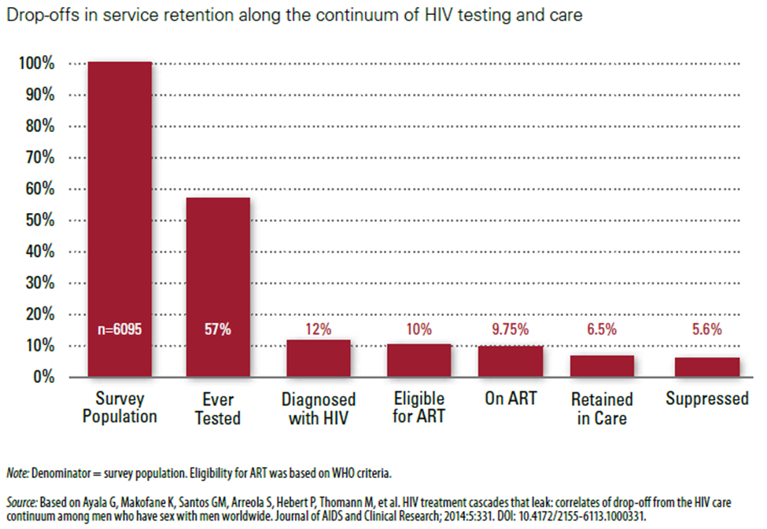
Lack of service access results in large drop-offs of Gay and bisexual men all along the HIV prevention, treatment and care cascade, reinforcing the epidemic:
Notes:
Enduring lack of access/funding to services due to stigma, discrimination, criminalization and violence results in large drop offs regarding access to test, treatement and care

Slide 7
What you should know
Meaningful engagement with community and CSOs: requirement for COP 2021 (7 CSO’s rep can participate in virtual meetings)
Key populations have to be meaningfully included in the process, and funding sufficiently allocated based on civil society recommendations
Necessity of evidence-based interventions as per normative guidance issued by bodies like the WHO and UNFPA
First document to consult to determine existing PEPFAR commitments to KPs in your country = most recent COP/ROP document.
Notes:
Key populations and their allies have spent years advocating for the meaningful inclusion of KP priorities in PEPFAR decision-making processes, prevention programs, and in legislation passed in the U.S. Congress that provide PEPFAR funding (the initial law operationalizing PEPFAR, then an unprecedented commitment to combat HIV around the world, made no mention whatsoever of gay men or other men who have sex with men). COPs are long and detailed documents so it is important to review them carefully to determine commitments and gaps with regard to KP priorities. Sometimes there will be a dedicated KP section. At other times, KPs are referenced under different sections including prevention, testing, treatment, PrEP, and so on.

Slide 8
Annual COP/Rop calendar 2021

Slide 9
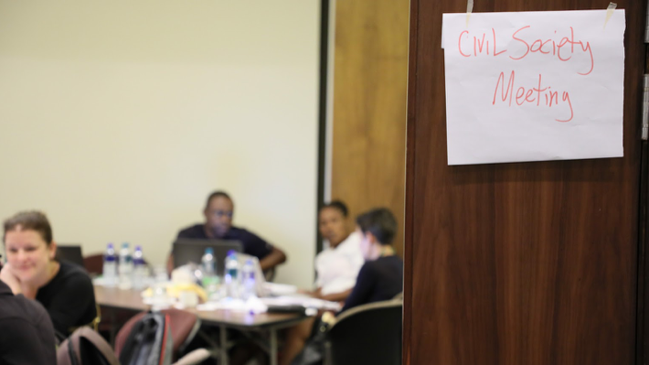
PEPFAR COUNTRIES
Group 1: Angola, Botswana, Eswatini, Lesotho, Mozambique, Namibia, Nigeria, South Africa, Zambia. (February 22-26, 2021)
Group 2: Côte d’Ivoire, Ethiopia, Kenya, Rwanda, South Sudan, Tanzania, Ukraine, Zimbabwe. (March 1 - 5, 2021)
Group 3: Burundi, Cameroon, Democratic Republic of Congo, Malawi, Uganda, Vietnam. (March 8 - 12, 2021)
Sunday Feb 16
Sunday Feb 21
Sunday March 1

Slide 10
Minimum services and activities in a comprehensive HIV/STI program for gay and bisexual men should include:
HIV testing and counseling
Risk reduction commodities
Community empowerment activities
Referrals
Addressing key structural barriers
Community led monitoring
Combination prevention programs are
Rights-based
Evidence-informed
Community-owned
Use a mix of biomedical, behavioral and structural interventions
Notes:
So what is the minimum package of services and activities to include in a comprehensive program for gay and bisexual men

Slide 11
Key elements: community empowerment
Notes:
MISMIT : Based on WHO’s 2011 Guidelines for HIV and STI Prevention and Treatment Among MSM and the 2014 Consolidated Guidelines for Key Populations
Developed to provide practical guidance in how to implement comprehensive HIV and STI programs for MSM around the world – a ‘cookbook’
Designed for MSM advocates, health workers, program managers, policy makers, donors and many other types of stakeholders

Slide 12
Examples of combination prevention approaches include:
Individual and group-level behavioral interventions
Sexual or other risk history-taking
Adaptive strategies, such as strategic positioning and serosorting
Voluntary medical male circumcision
Condom and lubricant promotion
Voluntary HIV testing and counseling
PrEP and PEP
STI and other sexual health services

Slide 13
TIPS
Insist on the engagement of key population communities in the design, implementation and evaluation of services for key populations
Ensure interventions are aligned with WHO Clinical Guidelines and other latest normative guidance available
Review existing normative guidance from WHO and UN agencies:
MSM Implementation Toolkit: http://msmgf.org/current-projects/msmit/

Slide 14
Addressing violence
Gay and bisexual men face high levels of stigma, discrimination, violence and other human rights violations
This gender-based violence (GBV) is rooted in homophobia and a perceived failure of gay men to conform to gender norms and expectations
Gay men can also experience stigma, discrimination and violence based on race, class, HIV status and other factors, compounding the negative effects of exposures

Slide 15
Exposures to violence against Gay and bisexual men are associated with increased risks for:
HIV/STIs
Depression
Suicide
Substance abuse
Other health concerns
These increased risks are due to:
Physical, emotional, psychological trauma
Social isolation, low self-esteem
Lack of access to services

Slide 16
Promising strategies and interventions to address violence against gay and bisexual men include:
Building capacity and self-efficacy, such as documenting violence and raising awareness
Working for legal and policy reforms
Fostering police accountability
Promoting safety and security
Providing health services
Providing psychosocial, legal and other support services

Slide 17
Stigma and discrimination programming
Addressing stigma and discrimination: central to implementing evidence-informed and rights-based HIV prevention, care and treatment services
Loss to follow-up along the HIV continuum is a major problem globally, especially among key populations because services are often stigmatizing.
Implementing a package of interventions to enhance community empowerment among key populations

Slide 18
TIPS
Insist that anti-discrimination technical assistance and programs targeting key populations are at the top of country program priorities
Sensitivity trainings for health care workers, focusing on addressing and reducing stigma and discrimination directed at key populations, delivered with the involvement of communities.
Use available guidances for international, regional and local actors responding to acute violence against key populations

Slide 19
2021 U.S. PEPFAR COP Reviews: Tips for Advocates

Slide 20
2021 U.S. PEPFAR COP Reviews: Tips for Advocates
Urge governments to keep an unwavering focus on groups at highest risk for HIV acquisition and onward transmission – gay men, people who use drugs, sex workers, transgender people

Slide 21
2021 U.S. PEPFAR COP Reviews: Tips for Advocates
Advocate for realistic and reliable size estimates of key populations. Size estimates are used by PEPFAR to justify targets, which in turn determine funding
When size estimates are ridiculously low, national programs will underestimate community needs, set low targets, and therefore underfund services.

Slide 22
2021 U.S. PEPFAR COP Reviews: Tips for Advocates
Demand a role in monitoring access to and implementation of HIV services for your community. In COP2021, all PEPFAR programs are required to develop, support and fund community-led monitoring for treatment services, in close collaboration with independent civil society organizations.
Notes:
. Community-led monitoring can include activities designed to assess the acceptability, accessibility, affordability, quality of services, and client satisfaction. It can also include documenting the impact of punitive laws and policies as well as experiences of stigma, discrimination, coercion, blackmail, and violence on the way to and/or at HIV service organizations and clinics.

Slide 23
2021U.S. PEPFAR COP Reviews: Tips for Advocates
Ask country teams to include supplementary funding for support services tailored to the needs of young gay and bisexual men and other key populations. Services tailored to young gay men and other key populations are urgently needed to expand safe, sensitized, evidence-informed and rights-based services.
Notes:
his would be a good way to make country programs more ambitious. And although funding is generally expected to remain flat across countries and regions, PEPFAR country teams can also this year submit proposals that include a request for additional funds to support supplementary programs.

Slide 24
2021U.S. PEPFAR COP Reviews: Tips for Advocates
Ask for another separate stream of funding specific to key populations, similarly to KPIF which comes to an end in 2021.
While KPIF is a welcome and innovative approach designed to benefit KP communities, its limited resources have made it hard to undertake interventions at scale. The gains made may be lost when funding ends. PEPFAR should consider increasing the funding allocated to KPIF and to extending the performance period beyond the current two years.
Notes:
his would be a good way to make country programs more ambitious. And although funding is generally expected to remain flat across countries and regions, PEPFAR country teams can also this year submit proposals that include a request for additional funds to support supplementary programs.

Slide 25
2021 U.S. PEPFAR COP: Tips for Advocates
Call-out the deleterious impact that the global gag rule is having on a country’s ability to reach its targets ; and insist on better coordination between the U.S. and other bilateral and multilateral funders to ensure clinics and organizations losing funding because of the U.S.’ global gag rule continue to offer HIV prevention, testing, care, and treatment, especially for key populations and women.
Notes:
.

Slide 26
2021 U.S. PEPFAR COP Reviews: Tips for Advocates
Tell U.S. PEPFAR missions to hold community-based, key population-led programs harmless to budget cuts AND urge them to take full advantage of additional or supplementary funds to support community-led programs.

Slide 27
2021U.S. PEPFAR COP Reviews: Tips for Advocates
Push for expanded technical support and sensitivity training for healthcare workers/providers, involving communities in the development of curricula and provision of those – stigma and discrimination experienced by key populations continue to undermine performance
Notes:
.

Slide 28
2021 U.S. PEPFAR COP Reviews: Tips for Advocates
Demand funds for structural and community-level interventions that can help facilitate enabling policy environments. Interventions include advocacy, community mobilization, demand generation, violence prevention and support, and legal services; provided by communities to communities – in addition to sensitization programs for healthcare workers, police, and policy maker
Notes:
.

Slide 29
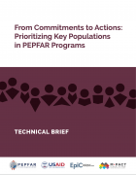
Download the Tech Brief in English |
Télécharger la Note Technique en Français
The recently released MPact technical brief
From Commitments to Actions: Prioritizing Key Populations in PEPFAR Programs provides detailed information and tips on how advocates can engage. This technical brief is intended for key population advocates and key population-led organizations who engage with PEPFAR mechanisms at the country and regional levels. It is a useful resource to better understand PEPFAR’s financial and policy-related commitment and to help KP communities successfully engage with PEPFAR’s annual planning processes.

Slide 30
Questions ?
Thank you! Merci
www.mpactglobal.org

