Slide 1
beyond slogans
Using data to understand and respond to lived realities
Keletso Makofane, MPH
Senior Programs and Research Consultant
Global Forum on MSM and HIV
New York, April 2016
Notes:
Give a picture of the response, whereas stef gave a picture of the epidemic
Begin to share with you the message that we at the Forum will be sharing throughout the civil society consultation. There is no end of the epidemic without a vastly improved response. And a vastly improved response is possible.

Slide 2
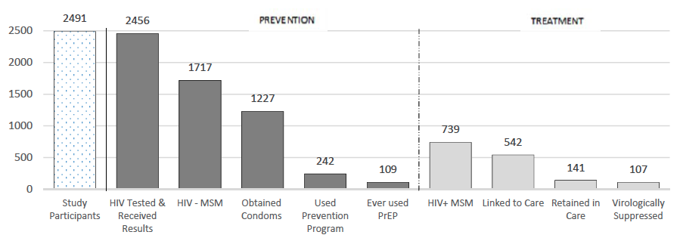
We lose people along the way
Ayala, G. Santos, G-M. 2016. JAIS. (Under Review)
Notes:
Utilization
treatment
25% are pos but not linked
Further 55% not retained retained in care
Leaving only 20% of those surveyed in care
Prevention
70% obtained condoms within past year
14 % participated in prevention program
6% had ever used PrEP

Slide 3
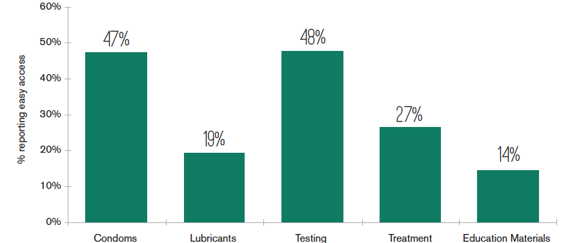
People have difficulty Accessing Services
Makofane et al. 2014. MSMGF
Notes:
Perceptions of Access
There is low access to services
This is the picture in a few African Countries
Call out global figures as well:

Slide 4
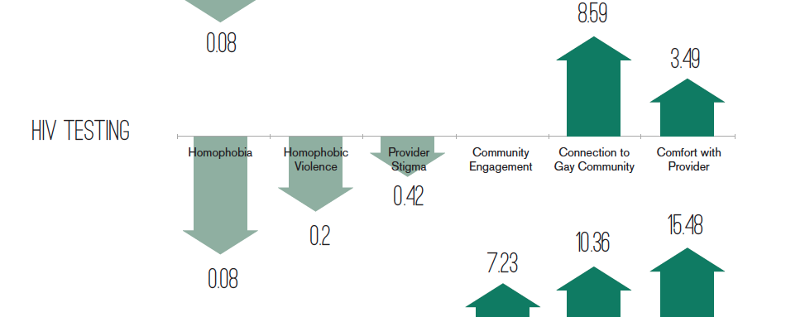
It matters how people are treated
Makofane et al. 2014. MSMGF
Notes:
Call out Service Delivery Location figures in JIAS paper

Slide 5
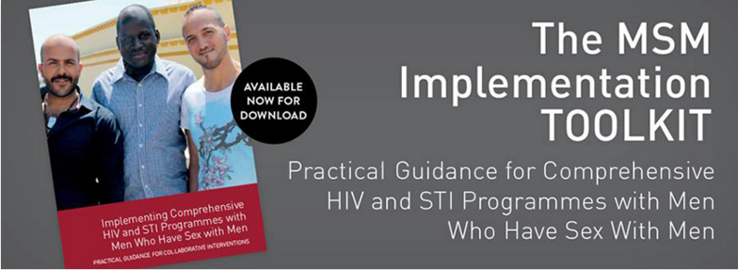
Notes:
Make the point that there are many organizations with a lot of experience and some of it has been condensed into tools like the MSMIT.
We need to figure out how to leverage this experience (the second panel will tackle that issue)
UNAIDS released:

Slide 6
Ending HIV and AIDS (for real)
Targeted Global and Local response
Decriminalize and De-stigmatize
Fund high-quality HIV programs
Notes:
Response to HIV has to respond to the particular challenges of gay men, bi men and other msm
The social environment has to be transformed. The capacity for doing that lies in community organizations.
David Traynor will speak last about how we are doing with funding

Slide 7
Thank you

