Slide 1
Enabling Policy Environments for more Effective HIV Responses among Gay and Bisexual and other Men who have Sex with Men
Vitaliy Karanda, Program Support Director
State Institution "Ukrainian Center for Socially Dangerous Disease Control of the MOH of Ukraine"

Slide 2
Ukraine
Ukraine is a country in Eastern Europe, bordered by 7 country’s.
It has an area of 603,628 km², making it the largest country entirely within Europe and the 46th largest country in the world.
With a population of about 44.5 million, Ukraine is the 32nd most populous country in the world.
Ukraine consists of 27 regions which are twenty-four oblasts (provinces) and one autonomous republic, Crimea. Additionally, the cities of Kiev, the capital, and Sevastopol, both have a special legal status.

Slide 3
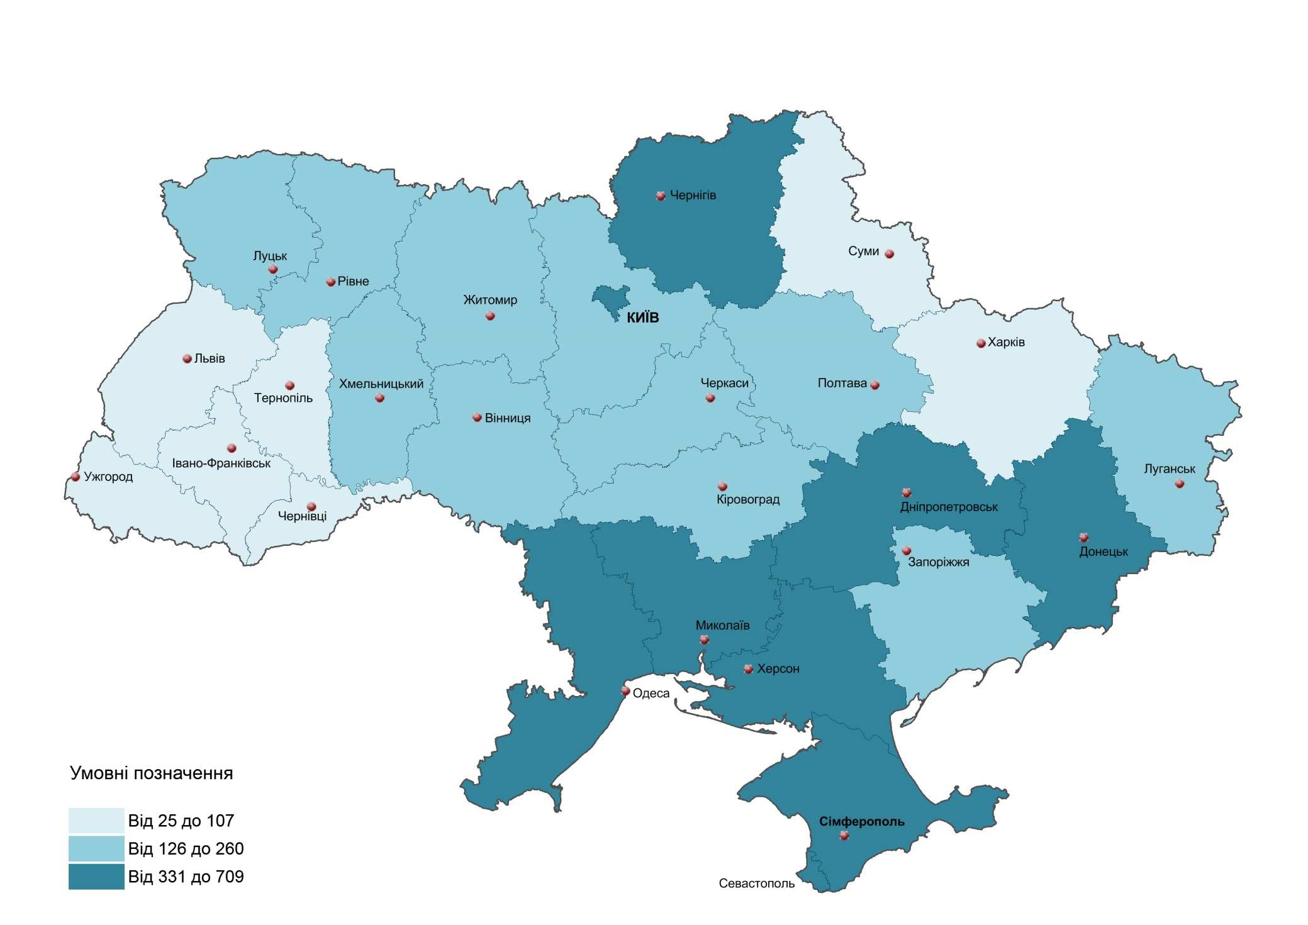
HIV/AIDS Epidemics in Ukraine as of January 01, 2016
Cumulative quantity:
HIV-infected persons – 280,358
Patients with AIDS – 84,045 Died from AIDS – 38,457
Clinical supervision:
HIV-infected persons –
126,604 (297,2 for 100 thousand population)
Patients with AIDS –
34,016 (79,8 for one thousand population)
Estimated number of people living with HIV/AIDS
(Spectrum 2015):
223,000 persons (15 years old and older)

Slide 4
Epidemiological and Programmatic Context
PLHIV: 232,793 or 0.78% of estimated adult prevalence (2015)
The epidemic is concentrated among vulnerable groups
HIV epidemic started in 1995 among PWID in southern and eastern regions
Shift of key mode of transmission from injecting to heterosexual in 2008; currently 69.2% (het.) vs. 29.6% (inj.)
A lot of heterosexual cases are still linked to injecting drug use
Growing role of MSM in HIV transmission, which is under-investigated and underreported
Considerable imbalance in access to treatment for key populations, particularly for PWID

Slide 5
Prevalence HIV among MARPs in Ukraine, IBBS data

Slide 6
Reported HIV Cases among Men who have Sex with Men in Ukraine
Clinical supervision:
HIV-infected MSM:
1,368 MSM – 1.1 % of all HIV
infected persons in Ukraine
MSM with AIDS –
203 MSM – 0.6 % of аll patients
with AIDS in Ukraine

Slide 7
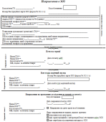
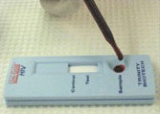
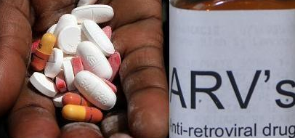
Standard Algorithm on Referral of Clients with Positive Results of HIV
Rapid Testing for Registration in AIDS Centers and Starting ART
Lost to follow up
~ 23 %
NGO 1
AIDS Center 1
Referral
HIV+
SYREX and HMIS Database
HIV+
NGO 2
AIDS Center 2
Referral
Lost to follow up
~ 23 %

Slide 8
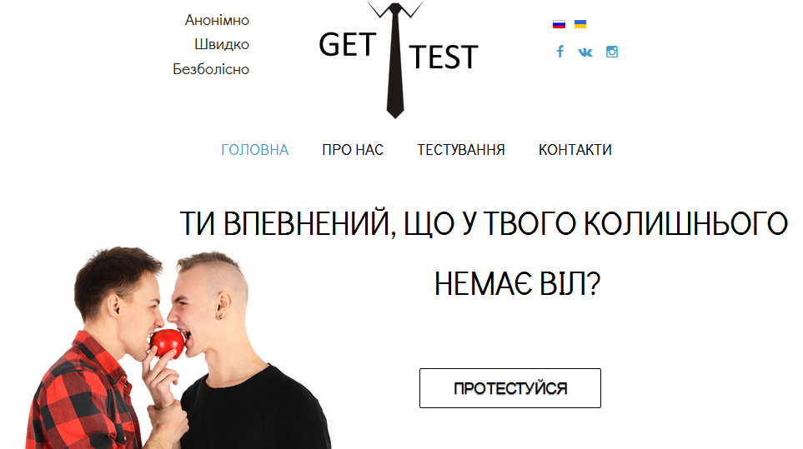
“Best Practices” on Referral of Clients with Positive Results of HIV
Rapid Testing
Social advertising and the launch of the site: http://gettest.com.ua/ua/
Register for HIV testing on the site and choose the most comfortable test points
Communication with social worker. Motivational counseling.
HIV counseling and testing (health care worker).
Post-test counseling, condoms, lubricants.
Social support in health care facility (AIDS Center).
The five-year USAID RESPOND Project, funded under the U.S. President’s Emergency Plan for AIDS Relief (PEPFAR) the project is being implemented by international NGO Pact in partnership with FHI 360.

Slide 9
Thank you for attention!

