Slide 1
HIV Risks and Vulnerabilities Among Gay, Bisexual, and Other Men Who Have Sex With Men
Stefan Baral, MD MPH FRCPC
Key Populations Program, Center for Public Health and Human Rights, Johns Hopkins School of Public Health

Slide 2
Outline
Epidemiology
Burden of HIV among Gay and Bisexual men and other men who have sex with men (MSM)
Levels of HIV Risk
Individual
Structural
Moving Forward

Slide 3
Global HIV prevalence among MSM, 2007-2012
Modified From: Beyrer, Baral, van Griensven, Goodreau, Chariyalertsak, Wirtz, Brookmeyer, The Lancet, 2012

Slide 4
HIV Prevalence among MSM in Africa
4.4%
(90)
4.9%
(1,778)
Morocco
Tunisia
5.7%
(259)
6.2%
(267)
5.9%
(262)
Egypt
21.5%
(463)
21.8%
(501)
19.0%
(n/a)
9.3%
(713)
7.3%
(406)
0.98%
(n/a)
17.2%
(1,291)
Senegal
50.0%
(96)
13.4%
(1,125)
21.1%
(712)
Sudan
9.8%
(205)
13.3%
(215)
Burkina Faso
17.0%
(n/a)
Nigeria
13.2%
(306)
24.6%
(285)
14.3%
(449)
The Gambia
Cote d’Ivoire
Togo
CAR
19.0%
(563)
Ghana
20.3%
(N/A)
37.0%
(511)
Uganda
25.0%
(N/A)
Cameroon
Legend
Kenya
19.8%
(253)
2005
Tanzania
12.3%
(509)
2006
Zambia
33.0%
(641)
2007
21.4%
(201)
3.1%
(353)
12.4%
(218)
Malawi
9.1%
(583)
Nampula
2008
19.7%
(117)
Beira
2009
Namibia
31.1%
(318)
8.1%
(358)
2010
Botswana
Maputo
40.7%
(285)
Maseru
8.1%
(358)
2011
25.5%
(200)
35.4%
(211)
Swaziland
2012
10.6%
(538)
28.9%
(249)
Maputsoe
2013
Soweto
Cape Town
Cape Town (Township)
2014
Modified From : van Griensven, Baral, et al. The Global Epidemic of HIV Infection among Men who have Sex with Men. Curr Opinion on HIV/AIDS, 2009

Slide 5
HIV Incidence among MSM in Sub-Saharan Africa
16.0%
Senegal
14.0%
Nigeria
3.6%
Uganda
7.2-20%
Kenya
7.1%
Malawi
5-6%
South Africa
Modified From : van Griensven, Baral, et al. The Global Epidemic of HIV Infection among Men who have Sex with Men. Curr Opinion on HIV/AIDS, 2009

Slide 6
HIV Incidence among MSM in Kilifi, Kenya
Source: Sanders, Mugo, van der Elst, Smith, Graham. High HIV-1 incidence, correlates of HIV-1acquisition, and high viral loads following seroconversion among MSM JAIS ,2013

Slide 7
HIV incidence among MSM, 1995-2013
Beyrer, et al, AIDS 2013
Notes:
Dashed lines represent countries in which annual incidence were not available
HIV among MSM in Kenya was 8.6/100py pooled; among MSME incidence was 35.3/100py and among MSMW was 5.8/100py. (Sanders 2013)

Slide 8
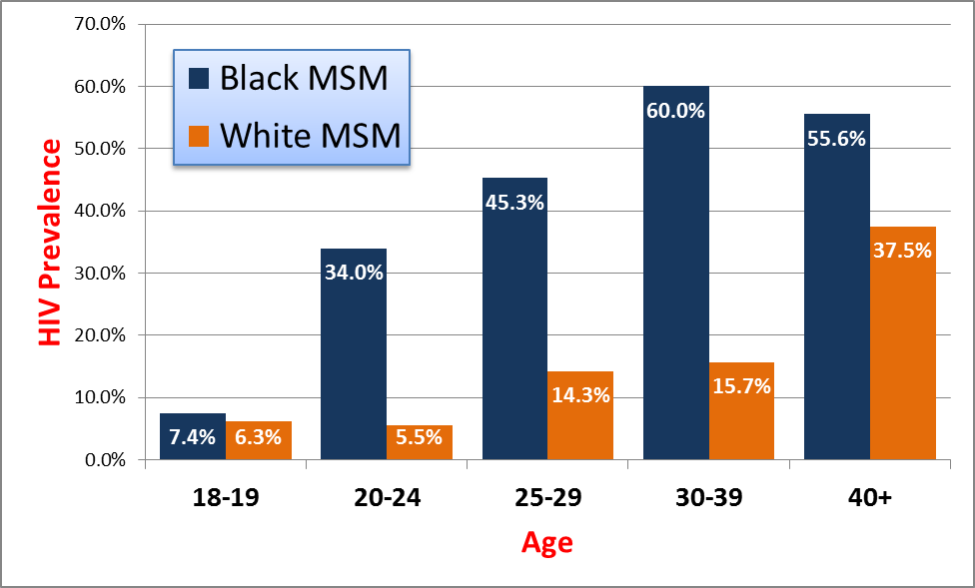
HIV prevalence, by race and age in InvolveMENt Cohort in Atlanta
Black MSM: 44% White MSM: 13%
Source: InvoleMENt. Sullivan, Rosenberg, Sanchez, et al. 2015. Used with Permission.

Slide 9
Levels of HIV Acquisition and Transmission Risks
HIV Epidemic Stage
Prevalent transmission of HIV in the population
Public Policy
Content and implementation of policies promote or decrease ability to decrease HIV risk
Community
Determines the access to safe and competent prevention., treatment, and care services
Can promote health and will-being or reinforce stigma and discrimination
Social and sexual networks
1) Group of people who are predisposed to risk based on sexual or parenteral exposures
2) Family and Social Networks can provide social support or reinforce protective social norms
Individual-Level
Biological or behavioral factors associated with
acquisition or transmission risks
Level of Risks
Stage of Epidemic
Public Policy
Community
Network
Source: Baral, Logie, et al. Modified Social Ecological Model of HIV Risk. BMC Public Health. 2013
Individual

Slide 10
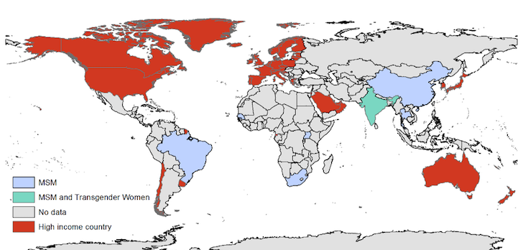
Map of low-income and middle-income countries reporting community level measurements for HIV risk among MSM and Transgender Women, 2000-2014

Slide 11
Depression and HIV/STIs among MSM in Lesotho
527 MSM completed structured survey instrument, biologic testing for HIV and Syphilis
Defined positive depression screen as a PHQ-9 score of 10 or more
Outcome variable | Adjusted Odds Ratio | 95% Confidence Interval
Laboratory test result
Positive for syphilis | 2.75* | 1.07, 7.08
Positive for HIV | 1.58 | 0.85, 2.94
Self-report
Diagnosed with any STI, past 12 months | 2.04* | 1.02, 4.06
Diagnosed with HIV, ever | 1.27 | 0.61, 2.63
Sources: Stahlman, Baral, et al. Depression and Social Stigma among MSM in Lesotho: Implications for HIV and Sexually Transmitted Infection Prevention. Forthcoming

Slide 12
Determinants of Depression Among MSM in Lesotho
Strong Positive Association with Stigma
Explanatory variable | Adjusted Odds Ratio | 95% Confidence Interval
Ever felt rejected by friends | 2.63** | 1.52, 4.54
Ever felt scared to walk around in public | 1.92* | 1.05, 3.50
Ever been blackmailed | 1.82* | 1.04, 3.19
Ever heard discriminatory remarks about MSM | 2.22* | 1.08, 4.55
Strong Inverse Association with Increased Social Capital
Explanatory variable | Adjusted Odds Ratio | 95% Confidence Interval
Social cohesion
Low | Ref | --
Medium | 0.48* | 0.28, 0.83
High | 0.49 | 0.24, 1.01
Sources: Stahlman, Baral, et al. Depression and Social Stigma among MSM in Lesotho: Implications for HIV and Sexually Transmitted Infection Prevention. Forthcoming

Slide 13
Effects of the Criminalization of Same-Sex Practices
Same-sex marriage bill introduced January, 2014 further criminalizing same-sex relationships and associations with community groups
Methods
MSM recruited through respondent-driven sampling and enrolled into a prospective cohort in Abuja from March 2013-June 2014
Characteristics related to discrimination and HIV care are described and compared pre-post legislation using chi-squared statistics
TRUST Model
UMD/IHV HIV Prevention and Treatment Services co-located with community group serving MSM (ICARH)
Sources: Schwartz, Nowak, Orazulike, Blattner, Charurat, Baral, TRUST Study Group (UMD, MHRP, ICARH, JHU). The immediate HIV-related impact of enacted legislation that further criminalizes same-sex practices in Nigeria. Forthcoming

Slide 14
Outcomes of Criminalization on HIV-Risks among MSM in Nigeria
Reporting of Discrimination and Stigma During Study Visits Pre and Post Legislation
Cumulative lifetime experiences of reported fear of seeking health care services across study visits (n=1,175 visits).
Sources: Schwartz, Nowak, Orazulike, Blattner, Charurat, Baral, TRUST Study Group (UMD, MHRP, ICARH, JHU). The immediate HIV-related impact of enacted legislation that further criminalizes same-sex practices in Nigeria. Forthcoming

Slide 15
Global Engagement in the Continuum of HIV Care among MSM
57.0% Ever Tested
Source: Ayala, Makofane, Arreola, Beck, Do. HIV Treatment Cascades that Leak: Correlates of Drop-off from the HIV Care Continuum among Men who have Sex with Men Worldwide. J AIDS Clin Res 2014, 5:8

Slide 16
Key Themes
Data Paradox
There is the least amount of data characterizing the needs of gay men and other MSM in the most stigmatizing settings
The world is more similar than it is different
Where studied across the world, gay men and other MSM have been found to have disproportionate burden of HIV
Highest incidence appears to be among young people
Comprehensive Research Agenda should include evaluating the content, scale, and implementation of HIV prevention, treatment, and care programs for MSM

Slide 17
Acknowledgements
The gay men, other men who have sex with men across the world who participate in these studies given significant risks and limited personal benefits
The community groups that make great personal and professional sacrifices to serve the unmet health and advocacy needs of those most marginalized in the HIV response
Contributions of Ideas and New Data
Eduard Sanders, George Ayala, Adrian Smith, Sari Reisner, Kevin Rebe, James McIntyre, Chris Beyrer, Patrick Sullivan, Daouda Diouf, and others
Key Populations Program, JHSPH
Sheree Schwartz, Shauna Stahlman, Sosthenes Ketende, Carrie Lyons, Gnilane Turpin Nunez, Iliassou Njindam, Clarence Yah

